Slide 1
Volunteers of America
988 & Crisis services
Shelene Richards
988 Program Coordinator

Slide 2
Current Programing
Regional crisis lines for the Greater Columbia, North Sound, and Salish Behavioral Health Administrative Service Organizations (BH-ASO)
988 crisis center for 32 counties in Washington
988 chat/text center for Washington State
988 chat/text national back-up center for Vibrant Emotional Health (NSPL)
Native and Strong Lifeline
Washington Indian Behavioral Health HUB
North Sound Crisis Follow-up Program

Slide 3
988 or Regional Crisis Line?
988 is not replacing the current system of regional crisis lines in the state
Regional crisis lines are administered by BH-ASOs contracted through the HCA and sub-contracted out to crisis centers to provide 24/7 crisis line services
BH-ASOs are also responsible to provide DCR/Mobile Crisis Responders for community outreach. Some BH-ASOs also contract with crisis centers to dispatch the mobile teams
988 centers are appointed by their states
988 centers are required to be accredited and contracted with Lifeline/Vibrant
VOA has been an accredited “Lifeline” center since 2006
VOA operates both the regional and 988 service for North Sound Counties
VOAWW BH Department currently has over 272 employees

Slide 4
Why 988 Matters
Suicide is the 3rd leading cause of death for youth under the age of 15
It is the 2nd leading cause of death for young people up to 25
It is the 10th leading cause of death for all people in Washington State
988 is easy to remember in a crisis, therefore will be more accessible
The legislation that led up to 988 has created a vast increase in crisis center funding here in Washington

Slide 5
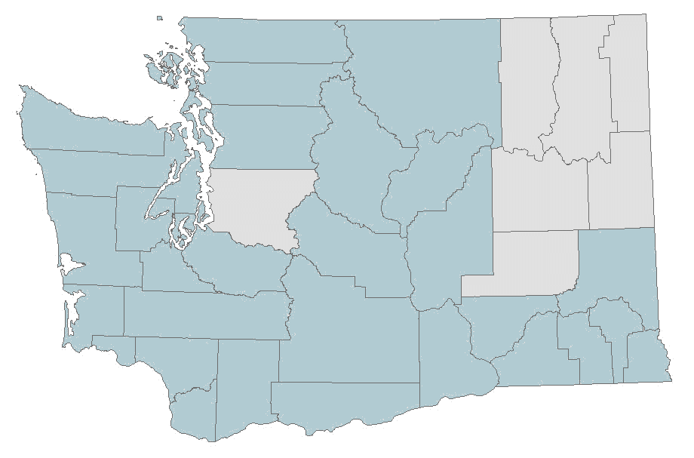
VOAWW 988 Services Overview
988 Phone Service
37 staff at VOAWW dedicated to 988 phones
Covers 32 counties in WA
988 Chat and Text
49 staff at VOAWW dedicated to chat and text
Covers all of WA State
VOAWW provides national backup services to answer chats that aren’t answered locally by other states

Slide 6

Native and Strong Lifeline
The Native and Strong Lifeline is an American Indian/Alaskan Native specific suicide and crisis line
The Native and Strong Lifeline is accessible by dialing 988 and is operational 24/7, 365 days a year
Native and Strong Lifeline calls are answered by other Natives
Native Crisis Counselors answer with their tribal affiliation. This does not mean exclusively tribal members
Our Native and Strong Lifeline counselors include enrolled tribal members, and descendants affiliated with their Native community or tribe
Suicide disproportionately affects Native American and Alaskan Natives
Suicide is the second leading cause of death among AI/AN people aged 10 years-34 years.

Slide 7

Continuum of Care: The Washington Indian Behavioral Health Hub
Resources
Culturally relevant options
Assistance with discharge planning
Coordination of care
Call the Hub at 1-866-491-1683
You will be connected with a Hub Navigator
Explain which resources are needed to your Navigator
Navigator locates resources from our database
Pass this information along to the caller
Follow up if allowed by the caller

Slide 8
Top 5 Reasons People Reach Out to Crisis Lines
988 or Crisis Line
988 Text & Chat
Suicidal Ideation or Self-Harm
Mental Health Crisis
Emotional Support
Resources
Connection
Suicidal Ideation or Self-Harm
Depression and anxiety
Family issues
Relationship issues
Bullying/problems in school

Slide 9
What resources/assistance is available to non-mental health providers dealing with the anxiety of supporting someone who expresses suicidal thoughts?
988 is a great resource for those dealing with anxiety and difficulties of assisting someone with suicidal thoughts. Calling 988 allows anyone to discuss and process their experiences with a counselor who is nonjudgmental and has time to listen and hear what the caller has to say. The counselor can also try and connect the caller with resources in their area for in person support. ​
https://afsp.org/find-a-support-group/ (American Foundation for Suicide Prevention) ​
https://www.samhsa.gov/find-help/national-helpline ( Substance Abuse and Mental health Services Administration) treatment options locator
https://www.nimh.nih.gov/ ( National Institute of Mental Health) Mental Health education and local community resource locator

Slide 10
Basic Components of Suicide Intervention
Show you care
Manage your own reactions
Maintain a collaborative relationship
Ask about suicide
Ask directly in a caring, non-confrontational way
Listen carefully to try to understand the reason they think suicide would help
Accept feelings without judgment
Connect them to help
Stay with the person, call or text 988 for guidance

Slide 11
Contact
988
  Call or text “988”
  Chat online at imhurting.org
North Sound Crisis Line
  1-800-584-3578
VOAWW Crisis Follow-up
  Call the NS Crisis Line
Native and Strong Lifeline
  Dial 988 and press 4 in WA State
Washington Indian Behavioral Health Hub
  1-866-491-1683
Shelene Richards– 988 Program Coordinator
  slrichards@voaww.org
Rochelle Williams – Tribal Operations Manager
  rwilliams@voaww.org
  Caitlynn Fuselier-988 Text/Chat Program Manager
  cfuselier@voaww.org

